Slide 1
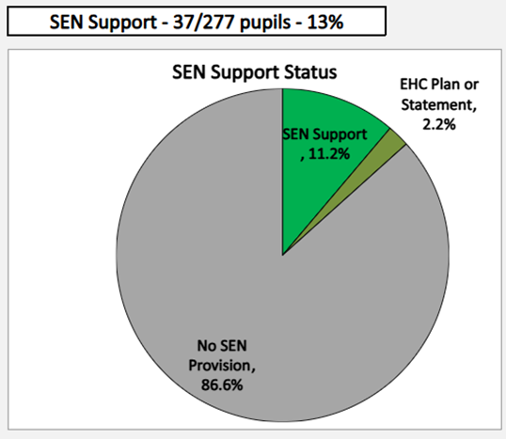
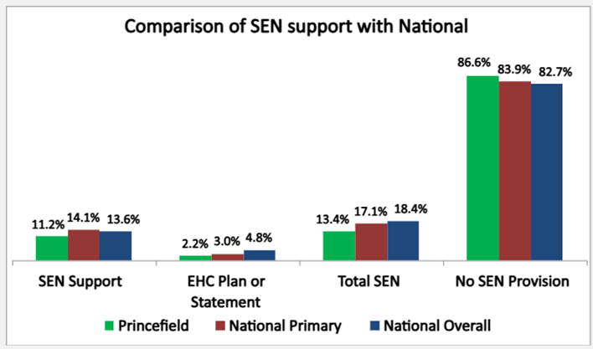
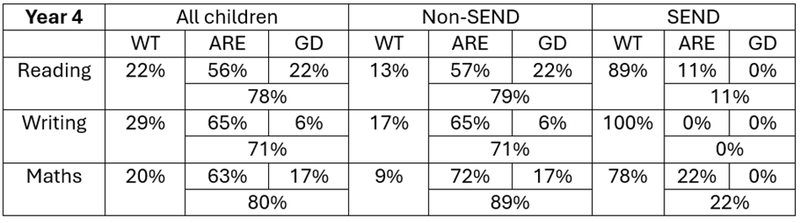


Identification of SEND in school:
Support provided by class teacher
Class teacher refer to SENCo
Humans Not Robots checklists to support identification of need
K support put in place and monitored termly
Outside agency referrals made for advice
EHCP application if no progress made
Princefield First School
SEND in a nutshell – Sept 2025
Attendance 2024-25
SEND E: 93% SEND K: 91%
Whole School: 94.7%
EXAMPLES OF GOOD SEND PRACTICE AT Princefield
Cognition and Learning Dyslexia friendly strategies Timetables intervention Alphabet Arc IDL Handwriting intervention Phonics interventions | Communication and Interaction Communication cards Social stories Lunch and break time support Check lists/Now & Next boards Speech and Language interventions Welcom & Stoke Speaks Out
Social Emotional and Mental Health Quiet time 1:1 mentoring Timeout time Social skills group | Sensory and Physical Daily sensory tools Sensory/movement breaks Work with advisory teachers Fine motor skills
Strengths of SEND in school:
Inclusive curriculum
APDR updated termly
Variety of interventions
Nurture support
Excellent links with outside agencies
2025 KS1&2 Data
To improve SEND our priorities are:
Ensure consistent levels of adaptive teaching across all classes.
Accurately monitor and measure interventions.
Improve communication with parents.
Behaviour
 | All pupils | SEN pupils | Non-SEN Pupils
Suspensions | 4 | 4 | 0
Permanent Exclusions | 0 | 0 | 0
Princefield Points awarded daily for effort, attainment and school values.
2025 EYFS Data:

Slide 2


