Slide 1


Penk Valley Academy Trust
Collaboration, Challenge, Curiosity and Care
Princefield First School
Special Educational Needs and Disabilities Information Report 2025-2026
Rationale
The information in this document describes our provision for learners with a Special Educational Need or Disability (SEND) and reflects Staffordshire’s Local Offer which can be found at https://www.staffordshireconnects.info/kb5/staffordshire/directory/localoffer.page?localofferchannel=0.
At Princefield, we strive to ensure that all learners achieve their potential personally, socially, emotionally and academically in all areas of the curriculum regardless of their gender, ethnicity, social background, religion, sexual identity, physical ability or educational needs. This report is intended to give you information regarding the ways in which we ensure that we support all of our learners, including those with special educational needs and disabilities, in order that they can realise their full potential. It may not list every skill, resource and technique we employ in order to achieve this as our provisions are continually developed and evaluated to meet the diverse and changing requirements of our learners.

Slide 2

Our Inclusion Team consists of:
Kate Maymand Special Educational Needs Co-Ordinator
Vicky Simpson, SEN TA
Becky Nixon, Headteacher
Class teachers
Teaching Assistants & Learning Support Assistants
Where necessary assessment, advice and guidance is also sought from our external agencies, for example:
• Autism Inclusion Team
• Speech and Language Therapist
• Educational Psychologist
• Specialist Sensory Support Services – HI/VI
• Family Support Services
September 2025 Information
Princefield First School currently has 277 children on role (September 2025).
There are currently 37 children on SEND register with a range of needs. (13% compared to last year 14.7% a decrease of 1.7%.)
25 children (9%) have a diagnosis or identification of need that requires low level targeted interventions, QFT and support planned by subject teachers.
6 children (2.2%) have a significant and complex need that requires support over and above in class provision.
6 children that have an EHCP (2.2%) requiring extremely tailored support monitored by the Local Authority.

Slide 3

How does the school identify and assess special educational needs and disabilities?
Information from parents and previous settings is a key source for us in identifying new learners with SEND.
At the start of Nursery/Reception all learners have their speech and language assessed, so that we can establish who might require targeted and specialist interventions.
In addition, as the term progresses and at regular intervals, teaching and support staff are asked to raise any learner who is not making expected progress or whom they have particular concerns about. They do this using the Barriers to Learning form and link to the school provisions document. We use the HumansNotRobots assessment tools as a guide. We also use dyslexia screeners, reading tests, spelling tests and other assessments to support. At this point a conversation will take place with parents/carers and young person to discuss options and strategies available to ensure the most appropriate support mechanisms are agreed and implemented.

Slide 4
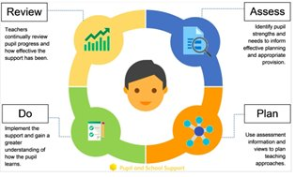
In School Referral and Monitoring System
APDR: Review provisions and targets termly.
Member of staff has concerns about a child’s needs.
Second APDR needed, add to the SEND Register.
Possible causes of action:
Complete suitable in school assessments/screeners.
APDR forms started by class teacher.
Discuss with parents.
Make referrals to outside agencies.
Discuss with other staff involved with the child.
After three terms without progress, consider EHCP application.
Or
Continue to support to maintain progress.
During the school day, put in place strategies to support the pupil.
Complete HumansNotRobots checklist as assigned by the SENDCO.
Complete a Barriers to Learning form and share with SENDCO.

Slide 5

How does the curriculum support the diverse needs of our learners?
Staff are required to uphold high expectations when both designing and adapting a coherent and ambitious curriculum. All learners remain at the heart of our school improvement plans as we aim to spark curiosity and excitement within them about the world, about themselves and each other, to help them to make connections between the composite parts of knowledge they are taught across different areas of the curriculum, and to provoke ambition through appropriate support and challenge in preparation for future education, work and life. Throughout the year, teachers and support staff are kept abreast of new initiatives through continual professional development delivered by the school’s SENDCo, specialist guest speakers and through our Trust. At Princefield all staff are required to complete annual safeguarding and health and safety training along with policy reading. Specific SEND training is also regularly scheduled to ensure staff knowledge, skill set, and approaches are enhanced and where appropriate externally accredited. We work closely with a range of outside agencies who both support our professional learning development and help us to quality assure our practice and procedures. In school we assess whether a young person has a special educational need or disability in different ways. We also monitor and review our inclusive teaching practice throughout the year.
• Observations and learning walks
• Subject reviews
• Teacher feedback
• School based test results
• Information from parents / carers
• Information from the child
• Specialist assessments carried out by outside agencies in collaboration with the school (with parent/carer consent)
• Transition information

Slide 6
What type of support is available for pupils at Princefield?
-Universal support: This includes high quality inclusive teaching, which considers the needs of all learners in the classroom.
-Universal plus/targeted intervention: This requires teachers to provide differentiated/scaffolded activities and create an inclusive learning environment. This also includes specific, additional interventions that target identified gaps or a delay in a learner’s development. The support is designed to accelerate a learner’s progress from their starting point. Often the intervention is delivered to support a small group of learners with similar learning, language or personal development needs. Learners in receipt of an intervention are identified as having “SEN support”. The pupil will have an APDR (Assess, Plan, Do, Review) – a document summarising their needs and strategies to support them in class that go beyond universal provision. It also outlines specific targets to clearly evidence desired outcomes and required provision. The school may work with outside agencies, parent/carers and the learner. The plan is usually reviewed on at least a termly basis with progress and next steps clearly noted.
-Highly personalised support/intervention- Education Health Care Plan: This includes specialist provision for a minority of learners where it is necessary to provide highly tailored interventions to support their academic progress and/or personal development. Learners receiving this intervention and/or access to specialist external support (on a 1:1/small group basis) are identified as having highly focused “SEN support”. Learners may need to undergo a holistic statutory assessment of their needs which may result in an Education Health Care Plan (EHCP) being applied for, agreed and issued by the Local Authority. Evidence in support of an EHCP needs to be gathered and clearly documented through the graduated approach; assess, plan, do and review cycle and noted within a young person’s APDR.
For further information regarding this process, follow the link:
https://www.staffordshire.gov.uk/Education/Access-to-learning/Graduated-response-toolkit/Graduated-response.aspx
If the LA’s Special Needs Assessment Team agree to progress with the request a pathway for new assessments is followed:
https://www.staffordshireconnects.info/kb5/staffordshire/directory/advice.page?id=H2NHUGE_yzY

Slide 7



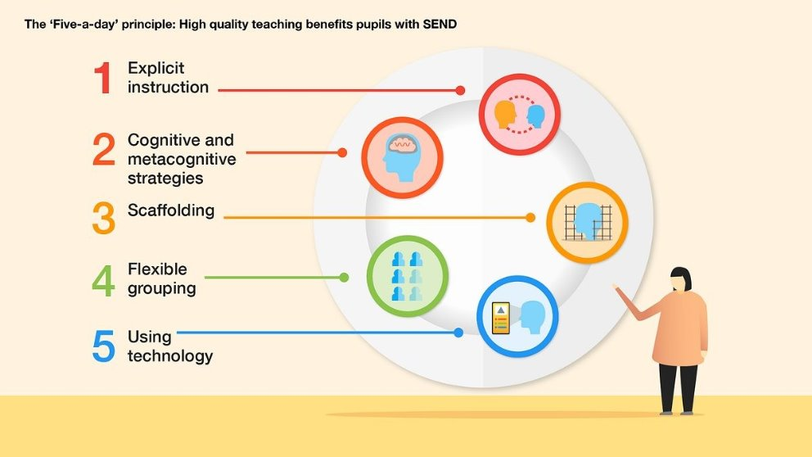

The list below is an example of the various targeted and specialist provisions which may be available to our learners as part of the graduated approach:
In addition, PFS promotes the recommendations made by the Education Endowment Foundation (EEF) in their support and teaching of students with SEND.
See link below
https://d2tic4wvo1iusb.cloudfront.net/guidance-reports/send/EEF_Special_Educational_Needs_in_Mainstream_Schools_Guidance_Report.pdf
Cognition and Learning:
Literacy intervention
Maths Intervention
IDL
Reading groups
Coloured overlays
Shared access to in class support
Access to ICT device for some learning
Communication & Interaction:
Stoke Speaks Out (App 1)
Blank levels
Speech and Language targets
Lego therapy
Mentoring for pupils with ASC
Communication cards
Lunchtime support
Social, Emotional and Mental Health:
Emotional regulation sessions
Nurture Group
Counselling referrals
Inclusive PSHE curriculum
Education Welfare Officer
Behaviour Support Services
Trusted adult support
Well chosen seating plans
Physical & Sensory:
Sensory breaks
Sensory diets
Fidget toys
Fine motor skills
Touch typing
Reasonable adjustments to rooms
Seating plans
Guidance from Hi/Vi team

Slide 8

The list below is an example of the various assessments available to our learners as part of the graduated approach:
IDL Literacy Screener
IDL Literacy Assessment
Accelerated Reader
IDL Numeracy Screener
IDL Numeracy 12 Strand Assessment
Child's Progress checker - Speech & Language UK (speechandlanguage.org.uk)
SEMH.co.uk Behavioural Indicator
Human Not Robots Checklists
Sensory Checklist (AIT)
Zones of Regulation SDQ
https://ican.org.uk/help-for-families/
Child's Progress checker - Speech & Language UK (speechandlanguage.org.uk)
Talk About SDQ
Level 7 Assessor tools as available
Fine Mine Skills Assessment (Fizzy Hands)
Stoke Speaks Out Speech Sounds and Developmental Tool
Touch typing (wpm)
KS1 and KS2 Pre-Key Stage standards (Literacy and Maths)
Handwriting assessment
Sensory Processing Needs Toolkit - Staffordshire and Stoke-on-Trent, ICS

Slide 9

How are pupils supported with transition?
During the summer term, prior to admission in Nursery or Reception, our Early Years team work collaboratively with any previous setting, parents and outside agencies to build a full picture of a child’s needs. For children that have an EHCP or require specific transition support, additional sessions are scheduled throughout the summer term offering parents and their children the opportunity to familiarise themselves with Princefield, key staff and our provisions is available.
We work closely with local Middle Schools and the same system is followed for those pupils leaving us in Year 4.
Having up to date and detailed APDR documents means that transition between year groups and keys stages is smooth. Staff have all the relevant information on current support strategies, as well as an archive of previously used interventions and resources and a full history of assessment and progress made by the pupil.
Information about transitions is shared with parents and pupils at the earliest possible date so preparations can begin both in school and at home.
How are resources allocated to meet pupils’ needs?
Pincefield supports to need, not label - Students do not require an identification of a condition in order to receive support.
The Notional SEND Budget is used to ensure all students on the SEND register, or those that are undergoing a period of monitoring, receive the support that they need. This money is not allocated to individual students and is used to fund the costs of support staff, interventions and resources. Those students with an EHCP receive the support specified in their individual plan and have a provision map detailing how support is allocated.

Slide 10

How do we report back to and collaborate with parents?
All learners will receive progress reports throughout the school year having undergone assessments detailing their attainment, effort and achievements from across their subject areas. Should teachers, pastoral staff or parents/carers have any interim concerns, home to school contact is essential in order to swiftly intervene and identify appropriate support/ways forward.
Parent/carers also have the opportunity to contribute to their child’s APDR which is completed by the class teacher, in collaboration with the pupil, support staff and SENDCo.
Parents of a child with an EHCP will also be asked to contribute to their annual review. This is managed by the SENDCo.
How do we collaborate with pupils?
All learners will receive progress reports throughout the school year having undergone assessments detailing their attainment, effort and achievements from across their subject areas. Should pupils be concerned about their results, they can discuss with their class teacher in the first instance. This will be referred on if needed to the relevant person.
Pupils also have the opportunity to contribute to their APDR, which is completed by the class teacher, in collaboration with subject teachers, pastoral staff, support staff and SENDCo.
Pupils with an EHCP will also be asked to contribute to their annual review. This is managed by the SENDCo.

Slide 11

How do we collaborate with pupils?
All learners will receive progress reports throughout the school year having undergone assessments detailing their attainment, effort and achievements from across their subject areas. Should pupils be concerned about their results, they can discuss with their class teacher in the first instance. This will be referred on if needed to the relevant person.
Pupils also have the opportunity to contribute to their APDR document which is completed by the class teacher, in collaboration with subject teachers, support staff and SENDCo. This is done termly.
Pupils with an EHCP will also be asked to contribute to their annual review. This is managed by the SENDCo.
We work closely with pupils to eradicate inequality and prejudice:
School Council members are a cross representation of pupils.
Behaviour management links closely to SEND, especially in supporting pupils with communication needs.
SEND TA works closely with pastoral staff to support SEND pupils.
SENDCo, HT and DHT work closely together around behaviour policies and restorations are personalised for individual pupils.

Slide 12


How is SEND provision evaluated?
Both our school provision and external support for learners with SEND are regularly monitored. This is embedded within the Trust and whole school quality assurance processes, performance management cycles, and is an aspect integral within our regular teaching and learning review systems. Attendance is tracked regularly, as is behaviour. Progress data is collected and analysed on a termly basis and reported on to our Local Governing Body. All findings follow a robust process, they are then actioned and closely monitored by senior leaders to ensure desired outcomes are achieved for our learners.
How do I contact the SENDCo?
In the first instance should a parent/carer have a query they would like to raise regarding their child’s needs, we ask that they make contact with the class teacher. The class teacher will refer on if needed.
If you would like to, you can contact the SENDCo directly the office can provide an email address. A face-to-face meeting or phone call can be arranged if needed.
How do I make a complaint?
We take parent/carer concerns seriously and will act upon these on an individual basis. In the first instance we would always ask that a parent/carer raises their concerns with their child’s class teacher. Should they have any specific questions/queries thereafter regarding their child’s support or provision contact should be made with the SENDCo via the school office. If a parent/carer is still unhappy about the resolution of their concern or if it is of a more serious nature, then this should be raised with the Headteacher. More guidance regarding the school’s complaints procedure can be found on the school’s website or can be requested from our school reception.

Slide 13
Linked Policies and Documents:
SEND Policy (PFS)
Safeguarding Policy (PFS)
Health and safety policy (PVAT)
Equality information and objectives (public sector equality duty)
Accessibility Plan (PFS)
Supporting pupils with medical conditions policy (PVAT)
Pupil Premium Policy (PFS)
Speech and Language Pathway (PFS)

Slide 14

Where can parents/carers go for further support?
The SENDCo can be contacted via the school office.
Staffordshire SENDIAS Service
Telephone: 01785 356921
E-mail: sfps@staffordshire.gov.uk
Website address is https://www.staffs-iass.org/home.aspx
Parent In The Know http://www.staffordshire.gov.uk/education/welfareservice/SpecialEducationalNeeds/spps/newsletter/newsletters.aspx
Staffordshire’s local offer https://www.staffordshireconnects.info/kb5/staffordshire/directory/localoffer.page?localofferchannel=0
Staff responsible:
SENDCo, Kate Maymand
Headteacher, Becky Nixon
SEND Governor, Emma Weaver and Nikki Russell
Review date: October 2026

Slide 15
MindEd for Families - https://mindedforfamilies.org.uk
MindEd is a free learning resource for the mental health of children, young people and older adults.
The National Autistic Society - http://www.autism.org.uk/
They are the leading UK charity for people with autism (including Asperger syndrome) and their families. They provide information, support and pioneering services, and campaign for a better world for people with autism.
ADHD Foundation - https://www.adhdfoundation.org.uk
The ADHD Foundation works in partnership with individuals, families, doctors, teachers and other agencies to improve emotional well being, educational attainment, behaviour and life chances through better understanding and self-management of ADHD, ASD and related learning difficulties such as dyslexia, dyspraxia, Irlen’s Syndrome, dyscalculia and Tourette’s Syndrome.
Down's Syndrome Association - https://www.downs-syndrome.org.uk
Children and adults with Down’s syndrome are all unique individuals with their own personalities, family backgrounds and preferences that make them who they are. Here you will find answers to questions that we are often asked about Down’s syndrome.
British Dyslexia Association -http://www.bdadyslexia.org.uk/
This organisation offers information, help and support for parents, children and adults with dyslexia.
Royal National Institue of Blind People (RNIB) - http://www.rnib.org.uk/
The Royal National Institute of Blind People (RNIB), the UK’s leading charity supporting blind and partially sighted people. They offer practical and emotional support to those that need support, so they can continue living life to the full.

Slide 16
National Deaf Children's Society - http://www.ndcs.org.uk
The National Deaf Children's Society is the leading charity dedicated to creating a world without barriers for deaf children and young people.
CAMHS and Young Minds https://youngminds.org.uk/about-us/who-we-are/
Child and Adolescent Mental Health Services (CAMHS) is the name for NHS-provided services in the United Kingdom for children, generally until school-leaving age, who are having difficulties with their emotional or behavioural well-being.
Relate - www.relate.org.uk
Relate is the UK's largest provider of relationship support, and every year they help over a million people of all ages, backgrounds and sexual orientations to strengthen their relationships.

Slide 17
Penk Valley Academy Trust
Collaboration, Challenge, Curiosity and Care
Appendix 1
Speech and Language Pathway
Rationale
One of the key areas of need within the PVAT schools is speech, language and communication needs (SLCN).
This document outlines the process each school follows in order to identify, support and refer pupils who need additional support.

Slide 18
In School System – identify, support, monitor, refer
This cycle begins for each new intake.
First half term all pupils in Nursery are screened for SLCN levels.
Pupils new to the school in Reception are also screened.
Second APDR needed, add to the SEND register. Consider Early Years Forum.
Follow SEND Register pathway.
After second term of intervention support, screener completed again.
Green – Expected EYFS provision continues.
Amber/Red – continue intervention.
Pupils flagged as:
Green – Expected EYFS provision continues.
Amber or red - placed in intervention.
Share with parents.
End of Early Years – use Stoke Speaks Out Prime Areas Development Tool, screenshot into APDR ready for Year 1.
Consider SALT referral.
Use Stoke Speaks Out pathway to assess and complete referral form.
After one term of intervention support, screener completed again.
Green – Expected EYFS provision continues.
Amber/Red – continue intervention.
Amber /Red pupils begin APDR. Share with parents.

Slide 19
The list below is an example of the various targeted and specialist provisions which may be available to our learners as part of the graduated approach for SLCN:
Stoke Speaks Out
Small group interventions
1:1 interventions
Speech and Language Therapist targets
Blank levels
Communication cards
Makaton/Signing
https://www.theberkeleycheshire.co.uk/communication-language-wellcomm/
Where can parents/carers go for further support?
The class teacher can offer advice and support.
The phase leader can offer further support.
The SENDCO or headteacher can be contacted via the class teacher or school office.
https://www.stokespeaks.org/
https://www.mpft.nhs.uk/services/speech-language-therapy-services-children
https://www.staffordshireconnects.info/kb5/staffordshire/directory/advice.page?id=kA3GYOhiDdE
Staff responsible:
Early Years Staff
SENDCo
Headteachers

